Slide 1
Resistors & Colour Coding
Objectives:
What is a Resistor ?
Types of Resistor
Parameters affecting resistance value
Determine the resistance of a resistor using the color code.
Discuss how exceeding its power rating can cause damage to a resistor.
Discuss the use of a variable resistor as a potentiometer.

Slide 2
What is Resistance ???
the action of opposing something that you disapprove or disagree with; "he encountered a general feeling of resistance from many citizens"; "despite opposition from the newspapers he went ahead"
any mechanical force that tends to retard or oppose motion
electric resistance: a material's opposition to the flow of electric current; measured in ohms
the military action of resisting the enemy's advance; "the enemy offered little resistance"
immunity: (medicine) the condition in which an organism can resist disease

Slide 3
Types of Resistors
Resistors are made in many forms but all belong in either of two groups:
  Fixed resistors – are made of metal films, high-resistance wire or carbon composition
  Variable resistors – have a terminal resistance that can be varied by turning a dial, knob, screw, or anything else appropriate for the application

Slide 4
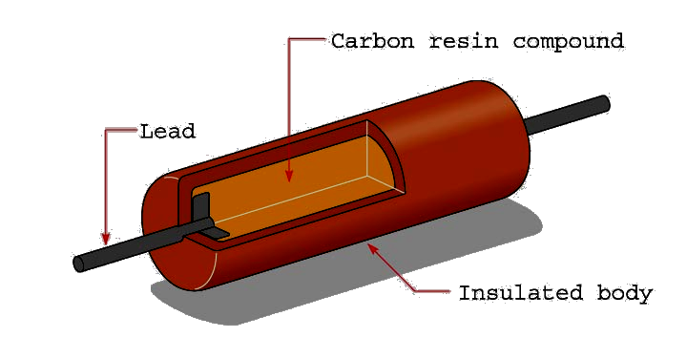
Resistors
Fixed resistors have only one ohmic value, which cannot be changed or adjusted. One type of fixed resistor is the composition carbon resistor.

Slide 5
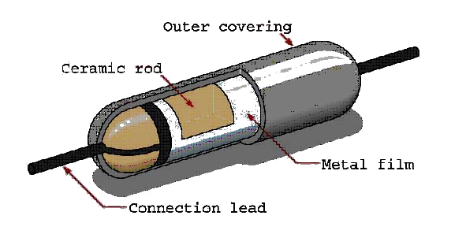
Resistors
Metal film resistors are another type of fixed resistor. These resistors are superior to carbon resistors because their ohmic value does not change with age and they have improved tolerance.

Slide 6
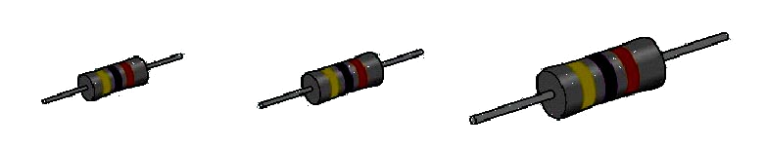
Resistors
Carbon resistors are very popular for most applications because they are inexpensive and readily available in standard sizes and wattages.
½ Watt
1 Watt
2 Watt

Slide 7
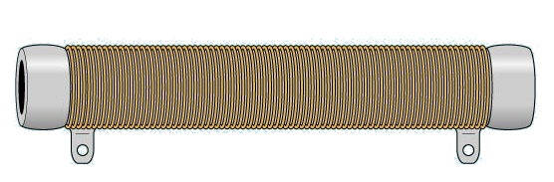
Resistors
Wire-wound resistors are fixed resistors that are made by winding a piece of resistive wire around a ceramic core. These are used when a high power rating is required.

Slide 8
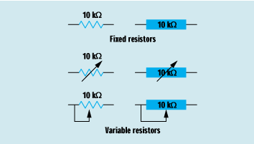
Resistors
Schematic symbols are used to represent various types of fixed resistors.

Slide 9
Types of Resistors
Variable resistors can have two or three terminals. Most have three.
Variable resistors are classified as a rheostat or a potentiometer, depending upon the application.
  Rheostat: Two- or three-terminal device used as a variable resistor
  Potentiometer: Three-terminal device used for controlling potential levels

Slide 10
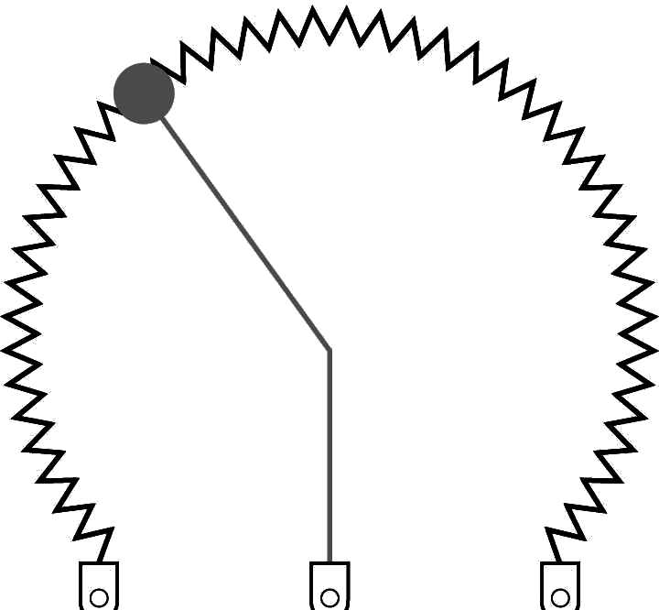
Resistors
Variable resistors can change their value over a specific range. A potentiometer is a variable resistor with three terminals. A rheostat has only two terminals.

Slide 11
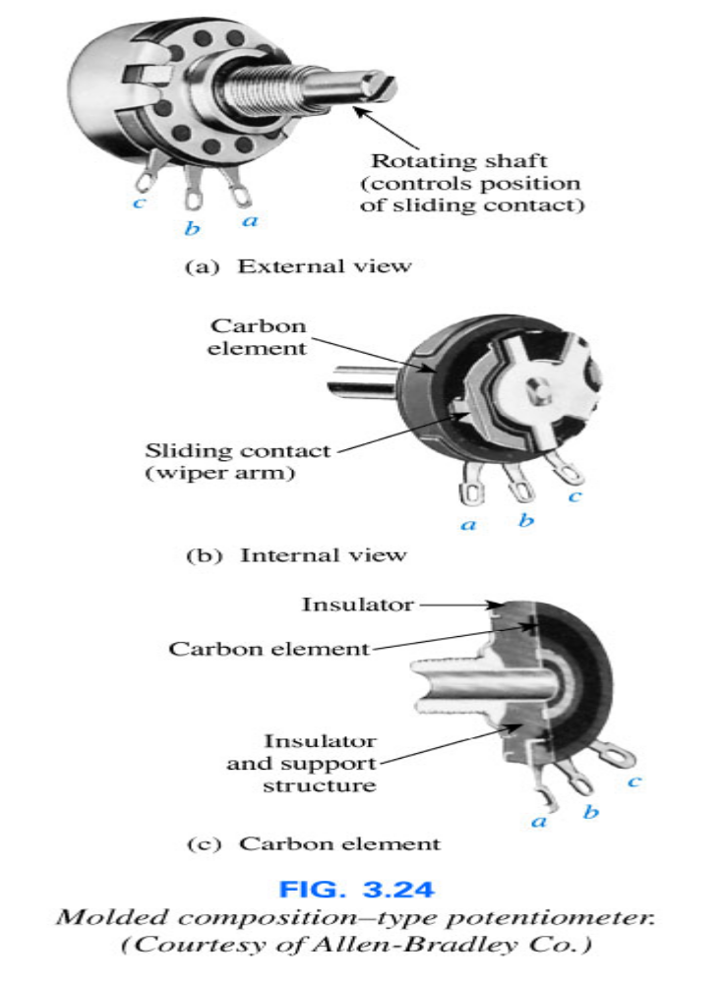
Types of Resistors
Most potentiometers have three terminals as shown.
The knob, dial or screw in the center of the housing controls the motion of a contact that can move along the resistive element connected between the outer terminals.
The contact is connected to the center terminal, establishing a resistance from a movable contact to each outer terminal.

Slide 12
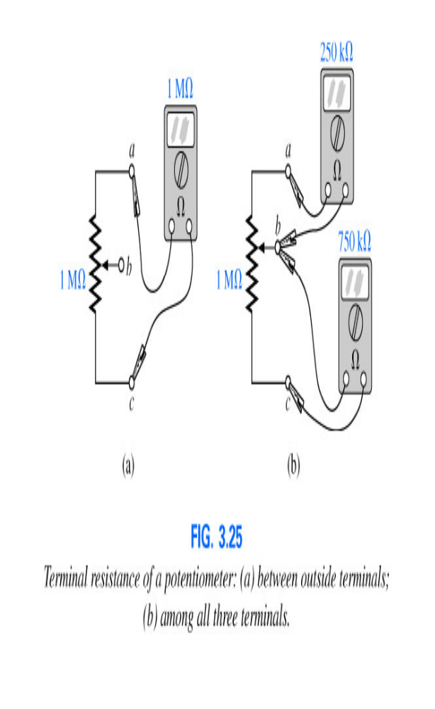
Types of Resistors
The resistance between the outside terminals a and c is always fixed at the full rated value of the potentiometer, regardless of the position of the wiper arm (b).
The resistance between the wiper arm and either outside terminal can be varied from a minimum of 0 Ω to a maximum value equal to the full rated value of the potentiometer.
The sum of the resistances between the wiper arm and each outside terminal will equal the full rated resistance of the potentiometer

Slide 13
Factors affecting Resistance
The resistance of any material with a uniform cross-sectional area is determined by the following factors:
  Material
  Length
  Cross-sectional Area
  Temperature

Slide 14
Resistance: Circular Wires
The higher the resistivity of a conductor, the higher its resistance.
The longer the length of a conductor, the higher its resistance.
The lower the cross-sectional area of a conductor, the higher its resistance.
The higher the temperature of a conductor, the higher its resistance

Slide 15
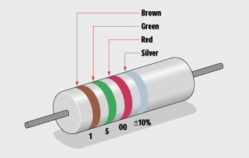
Resistors
The resistor color code can be used to determine the resistor’s ohmic value and tolerance.

Slide 16
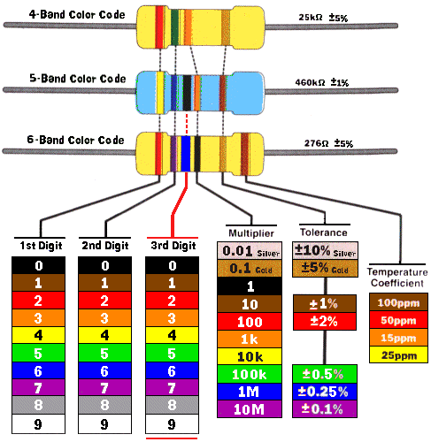
Color Coding

Slide 17
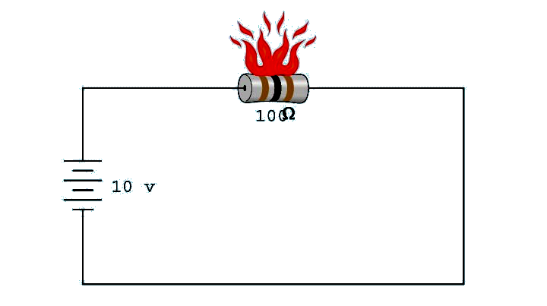
Resistors
Exceeding the power rating causes damage to a resistor.

Slide 18
Resistors
Review:
Resistors are used in two main applications: as voltage dividers and to limit the flow of current in a circuit.
The value of fixed resistors cannot be changed.
There are several types of fixed resistors such as composition carbon, metal film, and wire-wound.

Slide 19
Resistors
Review:
Carbon resistors change their resistance with age or if overheated.
Metal film resistors never change their value, but are more expensive than carbon resistors.
The advantage of wire-wound resistors is their high power ratings.

Slide 20
Resistors
Review:
Resistors often have bands of color to indicate their resistance value and tolerance.
Resistors are produced in standard values. The number of values between 0 and 100 Ω is determined by the tolerance.

Slide 21
Resistors
Review:
Variable resistors can change their value within the limit of their full value.
10. A potentiometer is a variable resistor used as a voltage divider.

Slide 22
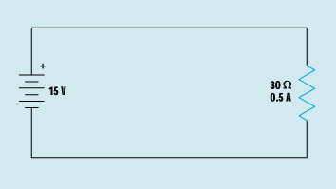
Resistors
Resistors are commonly used to perform two functions in a circuit.
The first use is to limit the flow of current in a circuit.
I = E / R
I = 15 V / 30 Ω
I = 0.5 A

Slide 23
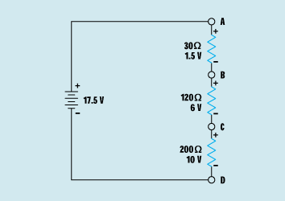
Resistors
Resistors are commonly used to perform two functions in a circuit.
The second use is to produce a voltage divider.
A to B = 1.5 V
A to C = 7.5 V
A to D = 17.5 V
B to C = 6 V
B to D = 16 V
C to D = 10 V

Slide 24

Brain Storming

Slide 25
Which materials is used for making wires ?
Which material is most widely used and why?
Which material is least used and why?

